Slide 1
NYCe TAXI !
Anand Anubhav Sindhuja

Slide 2
PROJECT GOALS
Maximize tip benefits for taxi drivers
A generic algorithm that can be extended to any city

Slide 3
DATASET
1
Source, Size, Relevant Fields

Slide 4
SOURCE
NYC Taxi and Limousine Commission
The data comes from several vendors who manage the meter/gps systems in the cabs
Source: http://publish.illinois.edu/dbwork/open-data/

Slide 5
SIZE
Merged from 2 datasets each spanning over 4 years - 2010 to 2013
Trips - 116 GB (uncompressed)
Fares - 75 GB (uncompressed)
Subset Chosen
Year 2013
Randomly sampled 10% of each month
200,000 records from above
Source: http://publish.illinois.edu/dbwork/open-data/

Slide 6
RELEVANT FIELDS
Unique Fields
medallion
hack_license
vendor_id
Trip Fields
pickup_datetime
dropoff_datetime
trip_time
trip_distance
pickup_latitude
pickup_longitude
dropoff_latitude
dropoff_longitude
passenger_count
Fare Fields
fare_amount
tip_amount
tolls_amount
total_amount
mta_tax
payment_type

Slide 7
ADDITIONAL SOURCE
US Census Data
Cost of living index
Median household income
Population Density
Available per Zip code

Slide 8
TOOLS USED
2
Libraries, Infrastructure

Slide 9
LIBRARIES & INFRASTRUCTURE
Language & Libraries
Python, BASH Scripting
Scikit, matplotlib
Infrastructure
IBM Softlayer Cloud
16 cores, 16GB RAM, 100 GB Hard Disk

Slide 10
DATA EXPLORATION & FEATURES
3
Data Cleaning, Data Visualization, Feature Engineering

Slide 11
DATA EXPLORATION
Filtering NA and missing values
Identifying outliers and incorrect values
Plots to detect outliers
Removed incorrect values Eg. Passenger count of 250
Visualizations to identify correlations with tip amount.

Slide 12
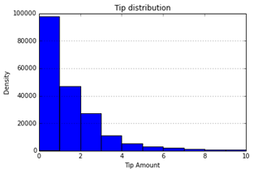
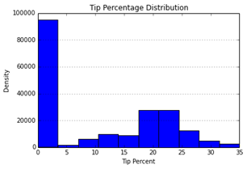
VISUALIZATIONS
Tip Amount Density Function
Tip Percentage Density Function

Slide 13
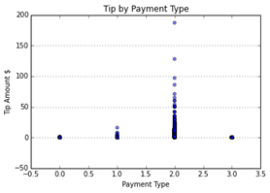
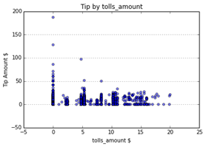
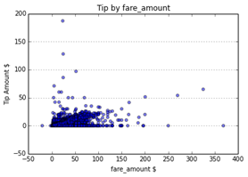
CORRELATIONS
Tip Amount vs Payment Type
Tip Amount vs Tolls Amount
Tip Amount vs Fare Amount

Slide 14
FEATURE ENGINEERING
Date-Time Based
Weekend/ Weekday
Time of the day
Location Based
Latitude-Longitude to Zip code
Zip code to boroughs
Boroughs to demographic data

Slide 15
MODELS & METRICS
4
Models, Algorithms, Analysis

Slide 16
MODELS
Tip - No Tip
Tip Class w/ Zero Tip Data
Tip Class w/o Zero Tip Data
Tip Percent Class w/ Zero Tip Data
Tip Percent Class w/o Zero Tip Data
Tip Amount

Slide 17
ALGORITHMS
Classification Models
SVM
Decision Tree
Random Forest
Adaboost
Regression Models
Linear Regression
SVM Regression
Lasso Regression

Slide 18
METRICS - CLASSIFICATION & REGRESSION
 | Baseline | SVM | Decision Tree | Random Forest | Adaboost
Tip - No Tip | 52.33 | 98.516 | 98.249 | 98.259 | 98.299
Tip Class w/ | 47.66 | 81.253 | 81.565 | 81.593 | 81.208
Tip Class w/o | 45.07 | 67.98 | 68.002 | 68.002 | 66.72
Tip % w/ | 47.66 | 68.10 | 68.08 | 68.097 | 68.013
Tip % w/o | 41.47 | 41.58 | 42.12 | 42.14 | 41.97
 | Baseline(Mean Abs Error) | Linear | SVM | Lasso
Tip | 1.38 | 0.75 | 0.79 | 1.254

Slide 19
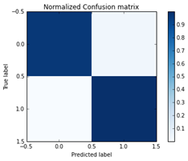
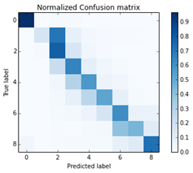
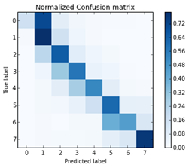
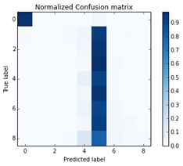
CONFUSION MATRIX
Tip - No Tip
Tip Class w/o Zero Tip
Tip Class w/ Zero Tip
Tip % w/ Zero Tip

Slide 20
INFERENCES & ROADMAP
5
Insights Gained, Future Work

Slide 21
INFERENCES
Card Payments have higher tip
Tip varies directly with fare
Routes with tolls yield less tip
Tip directly varies with the cost of living index

Slide 22
FUTURE WORK
Larger Data
More feature engineering
Apply the model to another city

Slide 23
QUESTIONS?
Thanks!

Slide 24
CREDITS
Special thanks to all the people who made and released these awesome resources for free:
Presentation template by SlidesCarnival
Photographs by Unsplash

